Slide 1
Week 3

Slide 2

From MLPs to CNNs for images
Sarina & Nick

Slide 3
Multi-Layer Perceptrons
Has an input layer, output layer, and at least one hidden layer
Require a one dimensional input vector
Every neuron connects to every neuron in the following layer
The Multilayer Perceptron (MLP) procedure produces a predictive model for one or more dependent (target) variables based on values of the predictor variables (ibm, n.d)

Slide 4
Convolutional Neural Networks
Operation used to scan an image with a small filter/kernel.
made from artificial neurons that learn weights
many layers of these computations connected together
Convolutional Neural Networks (CNNs) are unique neural networks for image recognition and computer vision (ibm, n.d)

Slide 5
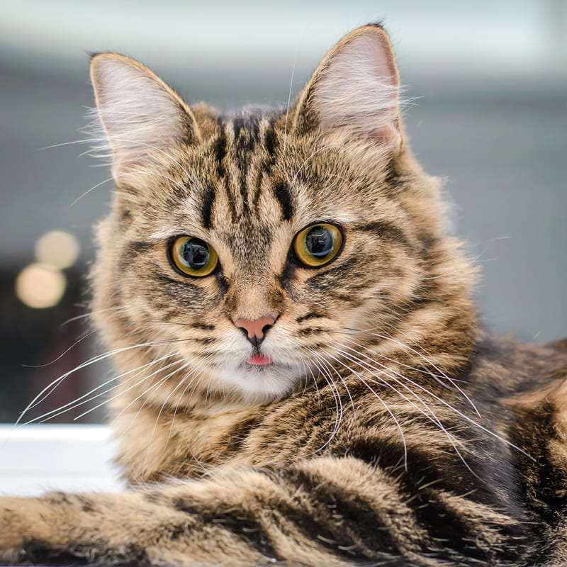
Convolution Layer

Slide 6
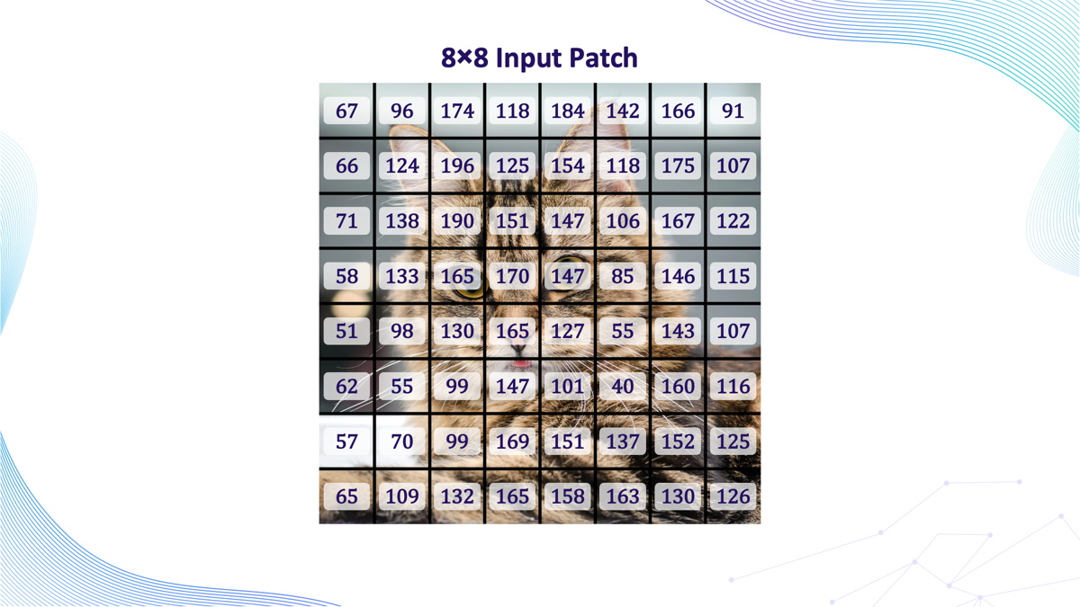
Notes:
Detects by brightness

Slide 7
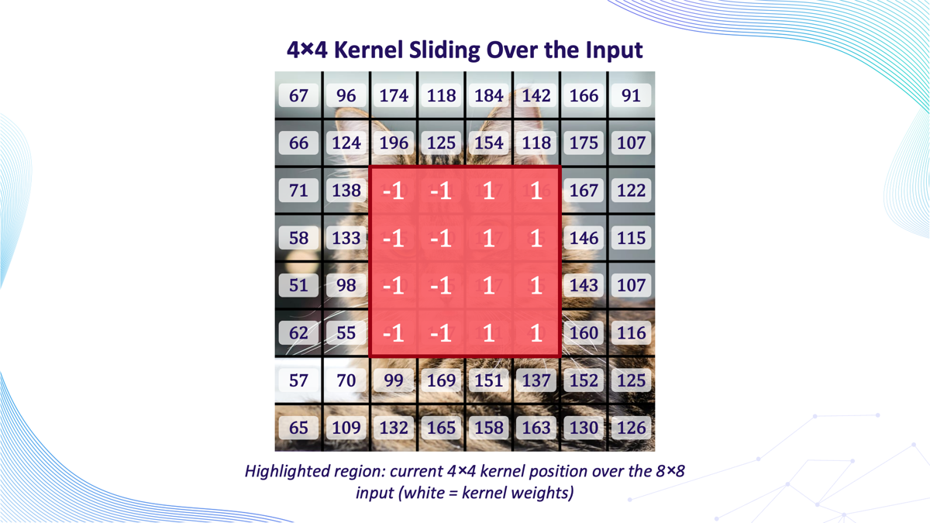
Notes:
The kernel we used is a vertical edge detector
It compares the average brightness on the left side of the kernal to the average brightness on the right side. If there's a big brightness difference between left and right — like where the cat's darker fur meets a lighter background — the kernel produces a large output (positive or negative). If the left and right sides are similar in brightness, the output is close to zero.

Slide 8
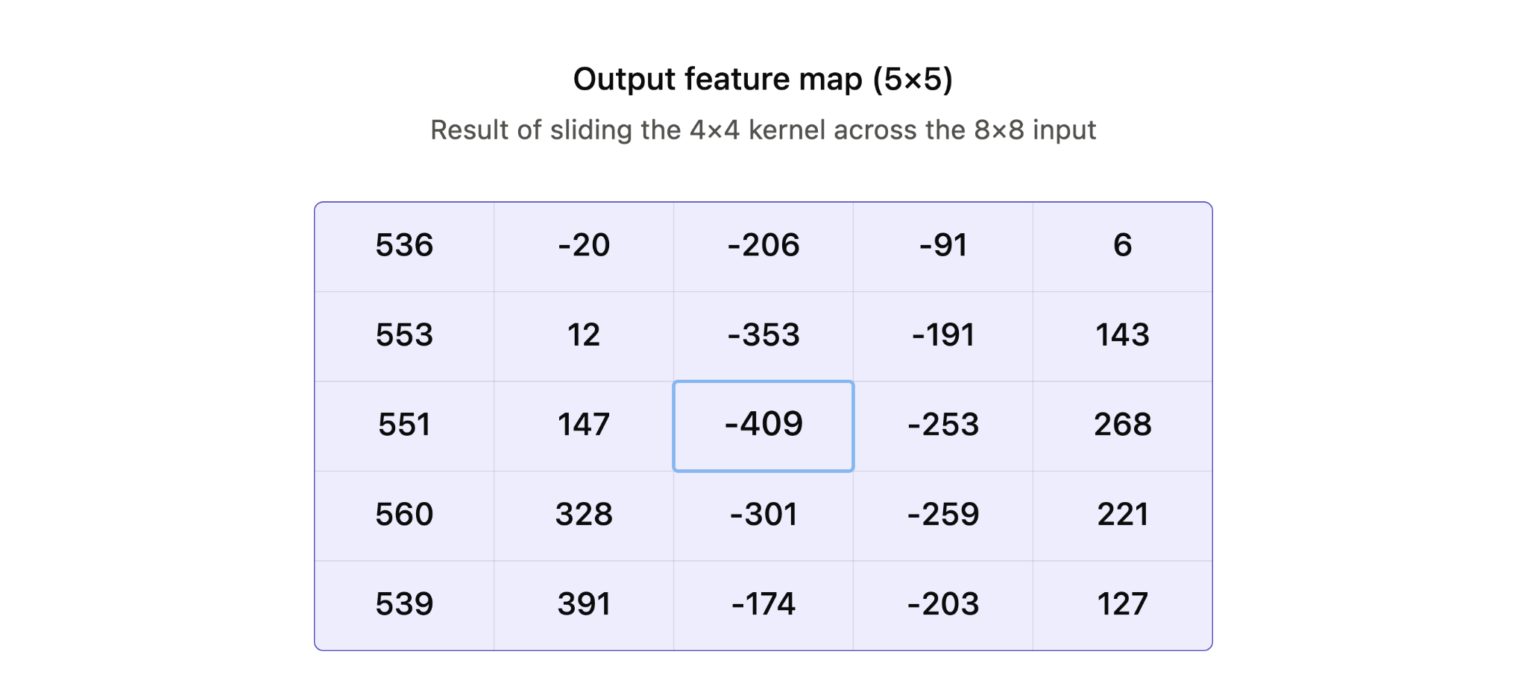
Notes:
Reuse the kernel over the whole image and get a feature map, so once it learns to recognize something in one place, it can spot it anywhere in the image
The left column (j=1) is strongly positive across every row (~536–560) — makes sense, since that column of the sliding window sits over the transition from background into the cat's face, where the left side of the patch is consistently brighter than the right.
The middle column (j=3) is strongly negative — that's the region centered right on the cat's eyes/nose area, where the pattern reverses.

Slide 9
Activation Layer
Pooling Layer
Fully Connected Layer
-100
442
-100
442
232
291
232
291
442
283
331
407
364
319
Notes:
Activation Layer (ReLU)-> After each convolution, ReLU passes positive values through and zeroes out anything negative
Pooling Layer-> Shrinks each feature map by summarizing small regions (e.g. 2×2) into a single value (max pooling keeps the strongest signal)
Fully Connected Layer-> Feature maps get flattened into one long list, then fed through a dense layer that combines everything to start making a decision.

Slide 10
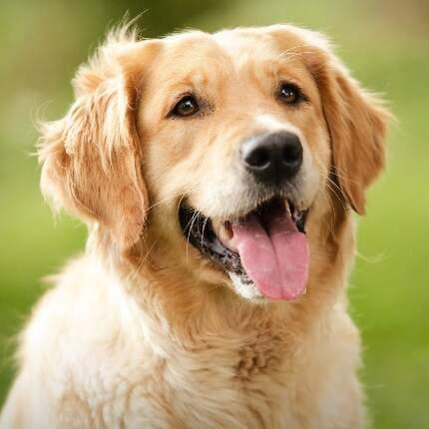
Classifier (Softmax)
Cat
Dog
Probability: 92%
Probability: 26%
442
283
331
407
364
319
Notes:
The final layer turns the fully connected output into a probability for each class
Softmax makes sure all the probabilities add up to 100%
Highest probability = the network’s prediction (e.g. “cat”)

Slide 11
Putting It All Together
Early on in convolutions, the network notices simple things (edges, lines, corners)
Those get combined into slightly more complex shapes (curves, textures)
Eventually those combine into recognizable objects (eyes, a wheel, a face)
Flattening happens at the end then classification.

Slide 12

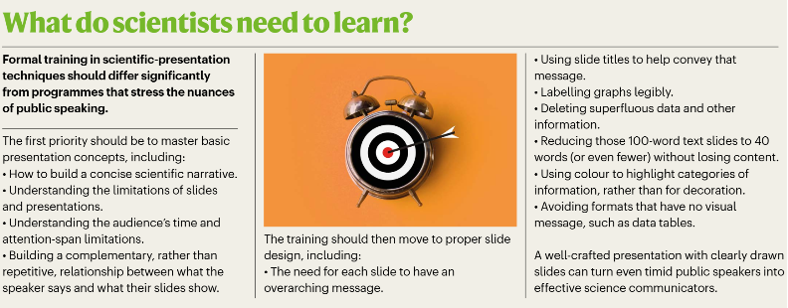
Polished Talks Benefit Careers
Review by Sarina & Nick

Slide 13

Review by Sarina & Nick

Slide 14
Week 4

Slide 15



Progress So Far
Received the dataset of images from biology professor.
Analyzed the folders/filenames to separate attributes
Wrote a script to run through the dataset
Designed a dashboard to represent current csv data.

Slide 16
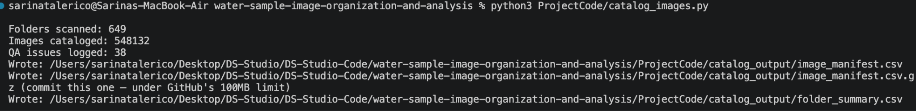
~550,000 images in the dataset
From the 648 total folders, 77 are raw, and 571 are -pp.
out of the 77 raw, 34 are pairs with -pp, and 43 are standalone

Slide 17
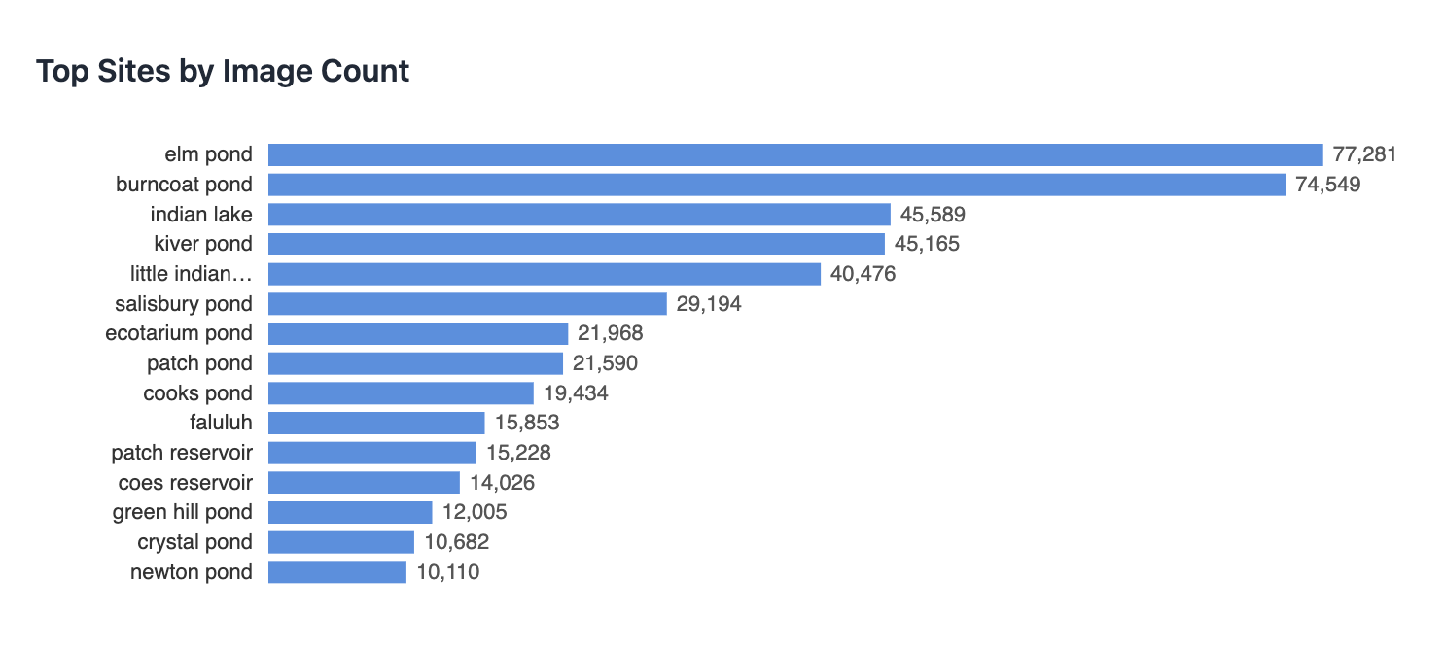

Slide 18
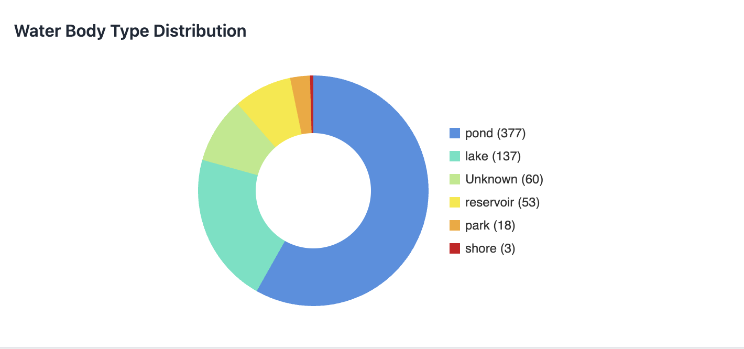

Slide 19
Challenges
-649 raw folders with no consistent naming convention
-Didnt know whether to normalize names or to separate them
-37 folders are missing magnification info
-Didnt know what -pp was; then discovered it wasnt a clean filter (90% success rate)
-Some -pp folders included duplicates from their raw counterparts

Slide 20
Prof. Ahlgren Update: Most Recent State
pp = post-processing
AI = autoimage mode; TR1/TM = trigger mode (preferred, standardized post-2022)
Dilution 0.1/0.5 = diluted 1:10/1:5; none listed = undiluted
Magnification: 10X standard, 4X for high concentration; none listed = assume 10X
Prefiltering: assume 50µm if noted
Notes:
; removes blanks (sometimes filaments too); use PP folders per city standard

Slide 21
Next Steps
Organize dataset using the PP folders (city's standard pipeline)
Include AI and TR1/TM as modes in csv file
Record prefiltration as attributes in the script
Incorporate the new 2024 dataset
Decide on a database to start using

Slide 22
Utility of Posters
Sarina & Nick
Notes:
The background of the "What Is the Utility of Posters?" paper establishes that while academic posters are extensively used at scientific conferences, their actual value to presenters and viewers remains poorly documented. Most existing literature focuses heavily on poster design and visual appeal rather than their effectiveness in knowledge transfer. Because of this gap, there is limited empirical evidence on whether posters truly facilitate learning or how they compare to traditional oral presentations. Consequently, the study investigates conference delegates' experiences to understand the unique strengths, weaknesses, and educational utility of poster presentations in academic and professional settings.

Slide 23
PROS
CONS
✓ Rapid updating
✓ Sources of inspiration
✓ Flexibility
✓ Enabling personalization of the conference program
✓ Facilitation of networking
✓ Good for early career presenters
✕ Too little information
✕ Less prestigious than oral presentations
✕ Challenging to prepare
✕ Monopolizing presenter's time at conference

Slide 24
Suggestions to Improve
+ Schedule adequate and dedicated viewing time
+ Central and prominent hub for the posters
+ Provision of an environment conducive to discussion
+ Requirement to display contact details
+ Show poster abstracts

Slide 25
Week 5

Slide 26
Progress
tune
01
language
02
account_tree
03
Script Optimization
Slight tweaks to script and dashboard to improve organization and clutter
Website Roadmap
Made two plans to move the project to a fully functional website
Visual Mapping
Created a visual representation of the two possible roadmaps made

Slide 27
Progress
04
tune
05
06
Met with Prof. Ahlgren
Met with the Biology professor to learn about the data and how they turn it into a dataset.
Cut 31,605 duplicate images from dataset
31,605 images were byte-identical duplicates present in both -pp and raw version. Redundant copies are eliminated by switching to -pp
Met with Prof. Catalin
Met with Professor Catalin who gave us advice on databases and how we should expect to work with our data.

Slide 28


Website Roadmap - $0/Month
Image Storage
01
Image Access
02
Database
03
Hosting
04
Cloudflare R2 free tier
Cloudflare Worker
Supabase free tier
Cloudflare Pages

Slide 29

Website Roadmap - $7/Month
Image Storage
01
Backend
02
Database
03
Hosting
04
Cloudflare R2 free tier
Render Starter
Render Postgres
Cloudflare Pages

Slide 30
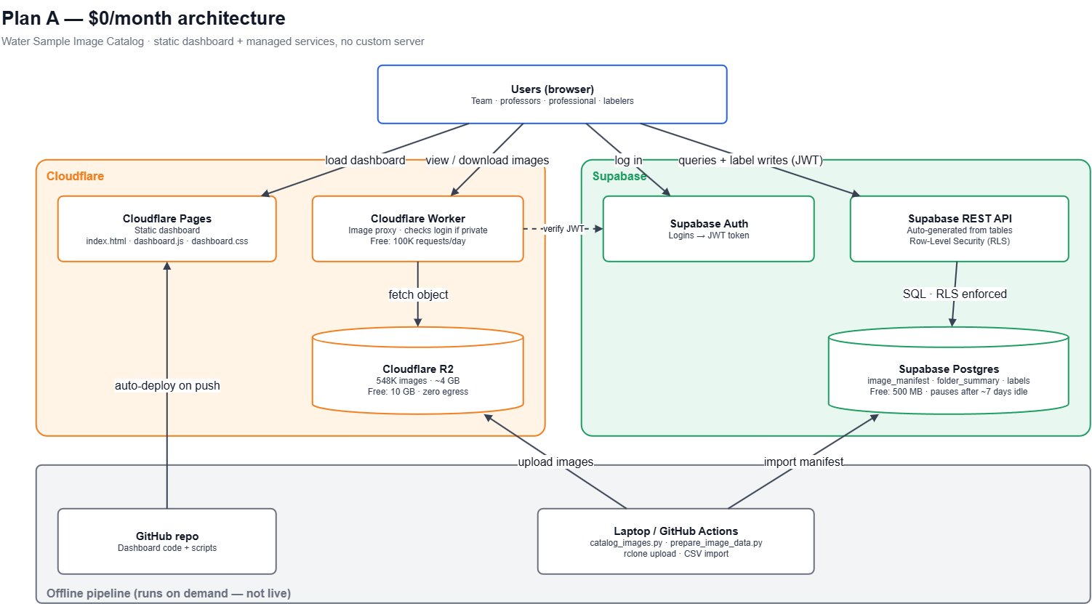

Slide 31
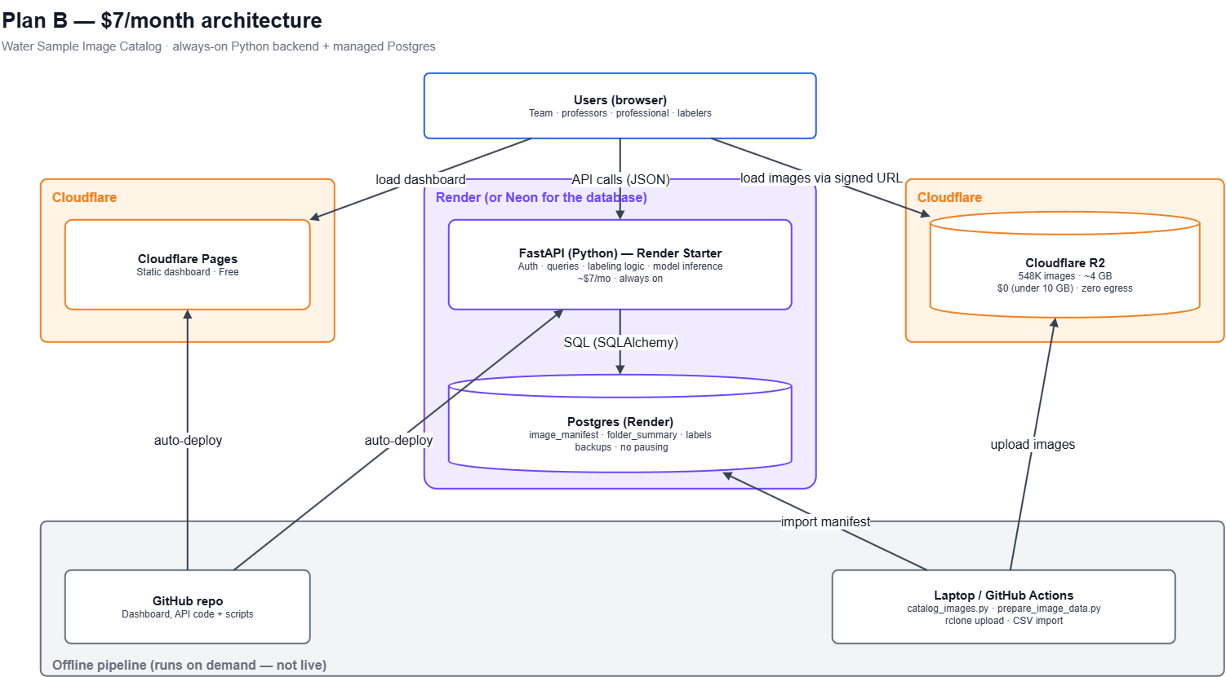

Slide 32


Challenges
wrong_location
Site Name Discrepancies
Need to confirm whether Patch Pond vs. Patch Reservoir, Coes Pond vs. Coes Reservoir are two different sites or inconsistent.
01
folder_off
Unprocessed Folders
43 folders are raw, and therefore inconsistent with the rest.
02

Slide 33
Next Steps
dataset
01
analytics
02
desktop_windows
03
psychology
04
Database Integration
Begin connecting the database to the current dataset.
AI Shift Analysis
Analyze how AI/trigger modes changed before vs. after 2022 in the data.
Visualization Software
Review Prof. Ahlgren's computer to use the visualization software for data.
ML & Labeling Strategy
Brainstorm a machine learning and labeling approach to the data.

